Slide 1



WEB PAGE BUILDER
MURUGAPPA POLYTECHNIC COLLEGE
Sathyamurthy Nagar, Chennai-600 062.
(An Academically Autonomous Institution)
DEPARTMENT OF COMPUTER ENGINEERING
PROJECT REPORT ON
Submitted By,
John Augustin N - 1912256
Madhan Raj D - 1912264
Mirthun K - 1912268
Santhosh P - 1912289
Yugendiran G - 1912299
Under the guidance of,
Mr. S. THIRUMALAI, M.E. Lecturer, Department of Computer Engineering

Slide 2
SYNOPSIS
There are number of coding languages available in order to build web pages. So, there is need to know any one coding language to build a web page. This innovative software application allows users to build web pages without knowing any coding language.
It is specifically designed for the internal use for companies. This software helps to build/design graphical Web pages. This software is embedded in a website for professional use, and will be available for customers to tailor web pages as per their need. This system helps the user to build web page with effective graphical user interface. User doesn’t have to work specifically for GUI. System will display various webpage template user can select any template according to his preference.

Slide 3
SYNOPSIS
This system will save time of the user and will help the user to concentrate on main functionality required in their webpage. This system will provide user with professional webpage templates they can select the templates based on the requirement and functionality. Here in this system user can build whole website by just selecting the content and images required in their webpage. User can design each and every web page in their websites according to their preference by selecting the content and images. User can even specify position of the content to be placed.
When user logins to the system, system will display various templates to the user. User has to select the template. He must specify the content and images that needs to be placed in the webpage. User can place the content and can view the template simultaneously. Once the user clicks onto the submit button system will generate the website. System will generate code and .zip file to the user. User can build custom websites easily using this application. User doesn’t have to know any coding languages to build web pages. With the help of this system user can work on main functionality required in their web page.

Slide 4
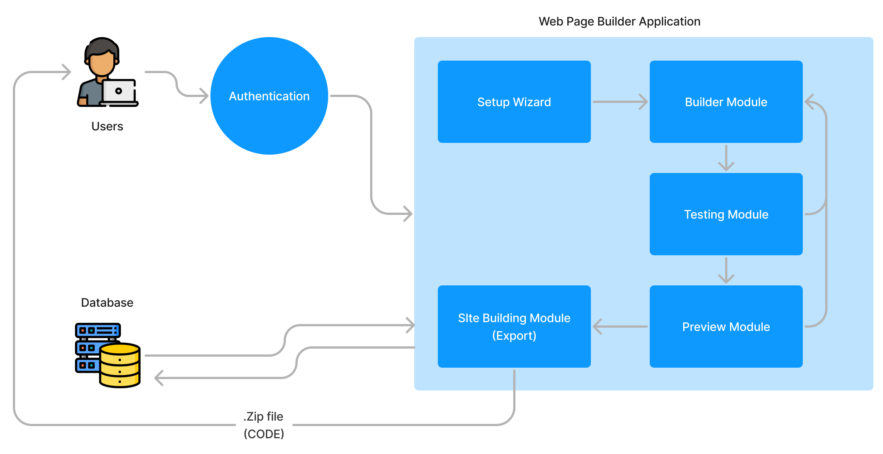
SYSTEM ARCHITECTURE

Slide 5
MODULES
Setup Wizard
Builder Module
Testing & Preview
Exporting
Database & Authentication

Slide 6
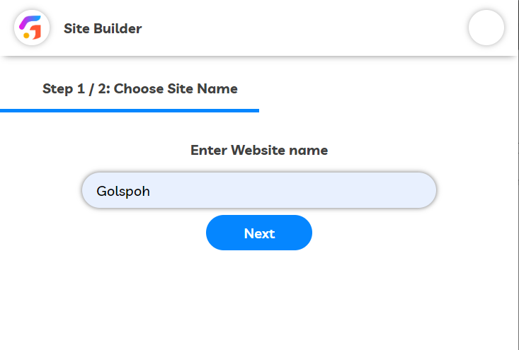
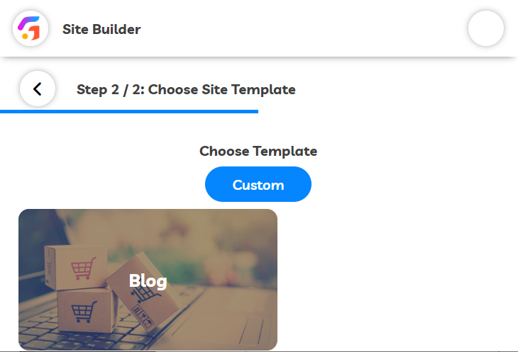
1. Setup Wizard
Setup wizard is the most 1st step in this application which allows the users to choose the site name and site template as per their requirements.

Slide 7
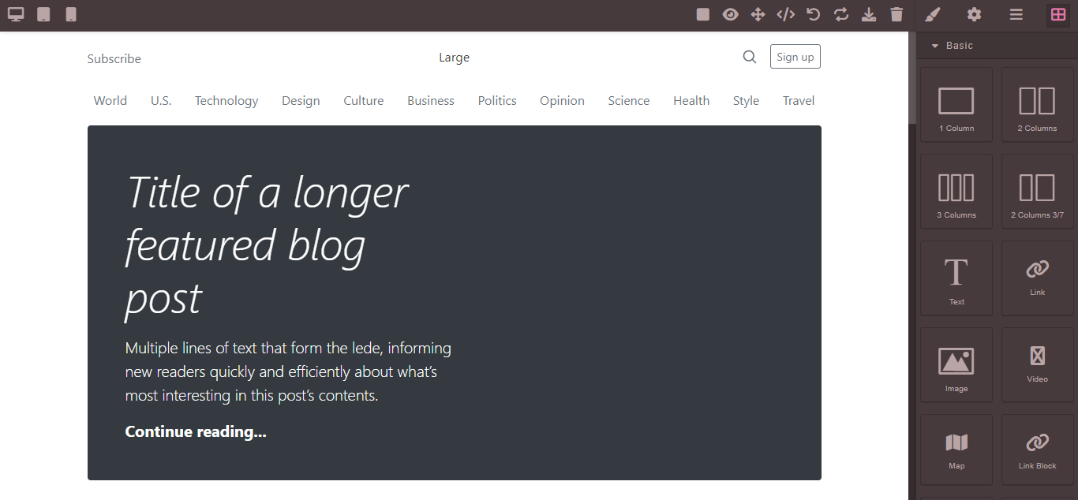
2. Builder Module
Builder is the important section in this application where the user chooses the site name and template then they can customize the template as per their expectations and requirements. This includes texts, headings, picture, etc.… everything can be customized by the user.

Slide 8
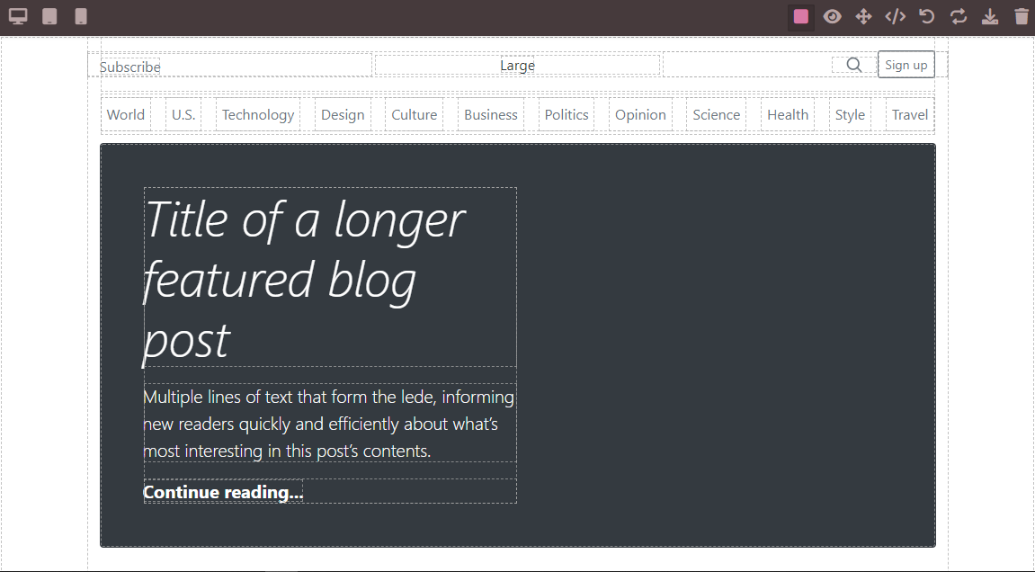
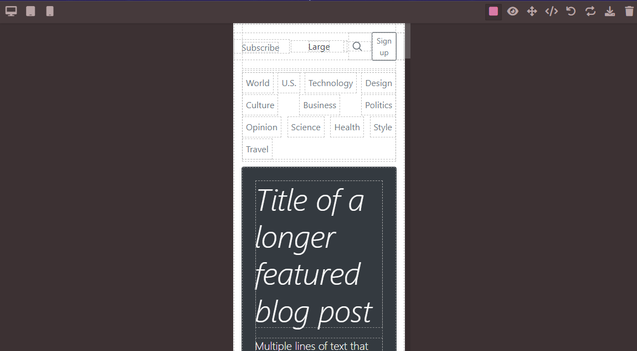
3.Testing & Preview
This module is responsible for testing the customized template such as responsibility, glitches, empty content, size, etc.… If any of the unsatisfied section found automatically user will redirect back to fix the problem in the template.

Slide 9
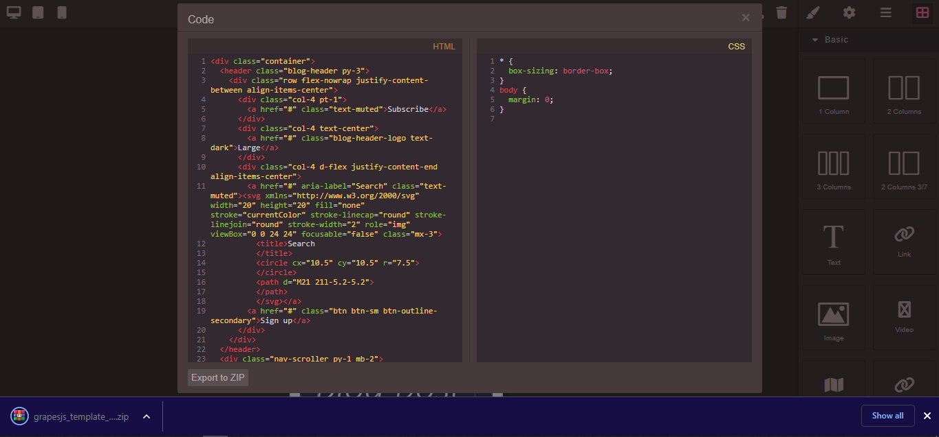
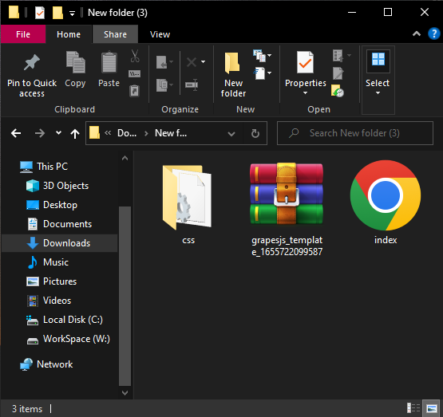
4.Exporting
Once the user customized the template as per the requirements they are finally now to export the site to code. The algorithm gets all the user’s customization and customize the template and save the archive of the site in the database.

Slide 10
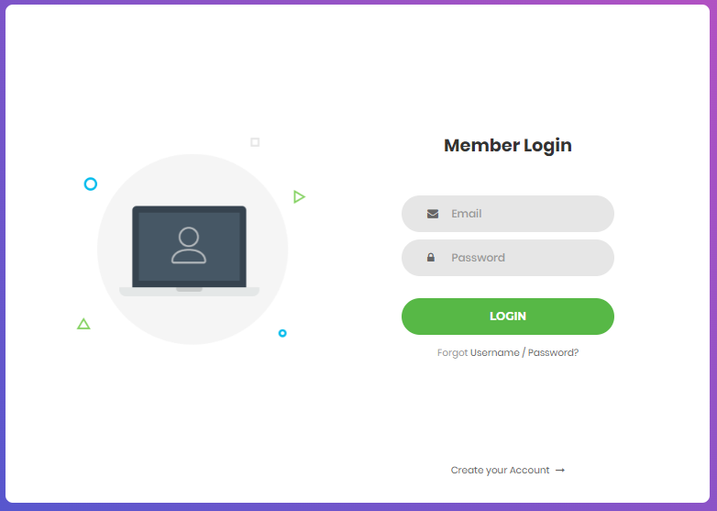
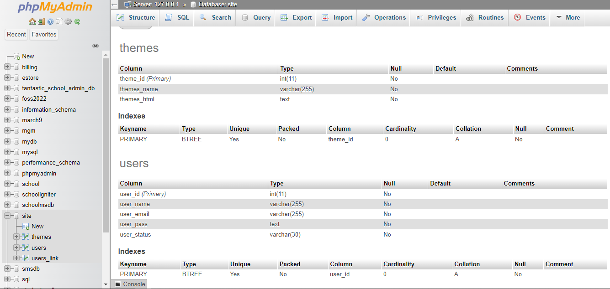
5. Database & Authentication:
Once the code exported to the database the user needs to be authenticated by the system to login the application. This is a process where the exporting module downloads the source code and the user can extract the file and use it.

Slide 11
USER FLOW
STEP 1
LOGIN
STEP 2
Choosing site name & template
Modify/ Build
STEP 4
Export and Extract
STEP 3

